Slide 1
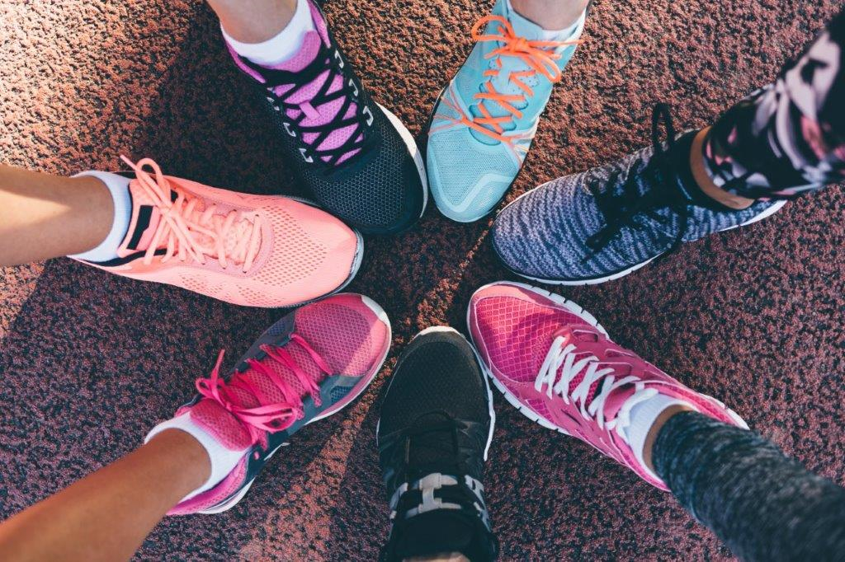

Introduction to
Trans and Gender Diverse Inclusion in Sport

Slide 2
What you will gain from this tutorial
Understanding
Learn about transgender (trans) and gender diversity in the sporting context.
Understand the needs and experiences of trans and gender diverse people in sport.
Skills
Learn how to encourage and promote supportive pathways into sport for trans and gender diverse people.
Find out how to make your club or organisation full inclusive for trans and gender diverse participants.

Slide 3
Benefits of becoming a more inclusive club
Open your club to more of the population
Invite people into your club who might not normally join
Increase your membership
Address gender inequity
Provide positive experiences to more people
Generate positive news for the club
Avoid a PR or media disaster and be ready and able to respond appropriately
Be seen as a champion in the community
Help improve the mental health of the trans and gender diverse community.

Slide 4
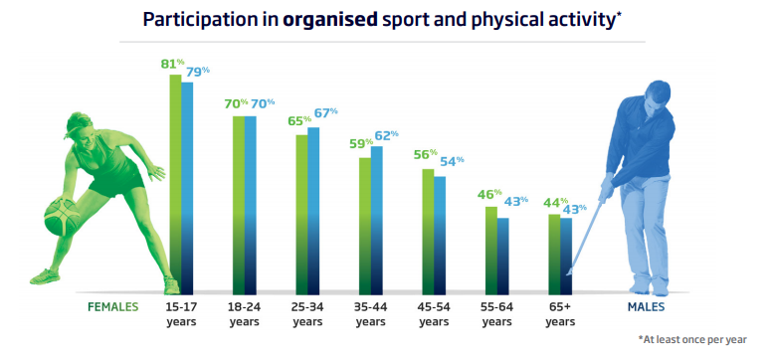
Trends in sport and physical activity
81% of Australians believe that it is important to be physically active, whether it be for sport, exercise or recreation.
The majority of Australians understand the physical and metal benefits of being active. They also believe sport brings people together, promotes a sense of belonging and helps instil a sense of pride in our communities. Australian Sports Commission Community Perceptions Survey, 2018.

Slide 5
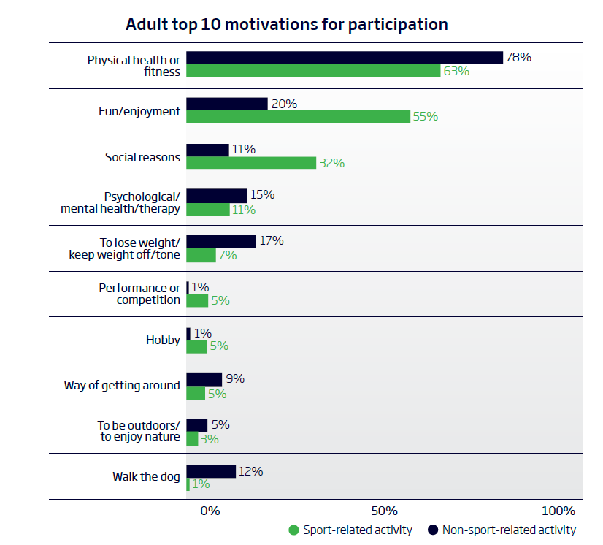
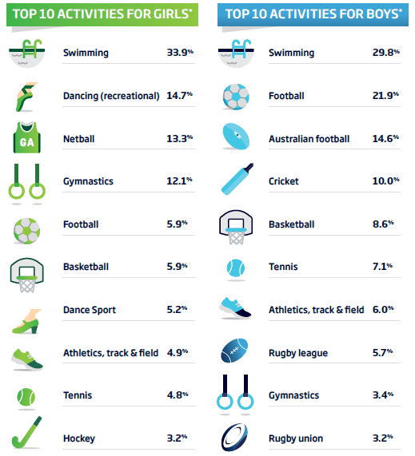
AusPlay: Participation data for the sport sector, 2016
AusPlay Focus Children’s Participation in Organised Physical Activity Outside of School Hours, 2018

Slide 6
Statistics
Young trans and gender diverse people want to play and engage with sport and exercise. However:
  46% of trans people thought sport was transphobic. (Equal Play Study, 2014)
  89% of trans young people experience peer rejection which impacts their ability to engage in actives such as sports. (Trans Pathways, 2017)
  81.7% of young people would like to exercise more, but don’t feel like they can because of financial barriers, discomfort and fear or unwillingness to exercise in public.
  60% of young trans and gender diverse people avoid change rooms, meaning many are put off by sporting clubs and spaces with no inclusive spaces to change, including gyms. (Blues to Rainbows report, 2014)
Notes:
Sports clubs and teams can be an accepting and affirming place for trans and gender diverse people. Their transition process may lead to several challenges, and team members and sports clubs can support a person through their transition (Storr et al., 2017).

Slide 7
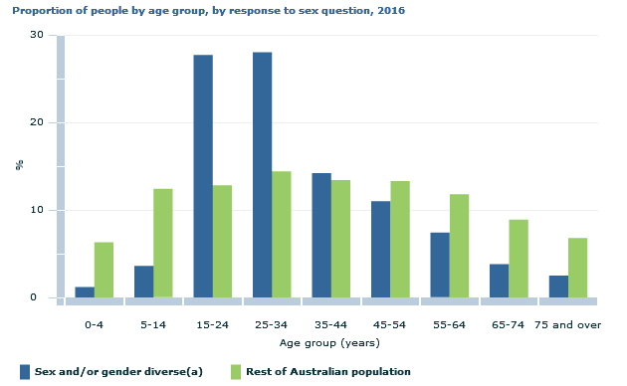
Statistics
The 2016 Census counted 1,260 sex and/or gender diverse people in Australia, but the ABS acknowledges this is a major underrepresentation.
Of those who identified as sex or gender diverse, 35% indicated they were non-binary or another gender.
26% reported they were trans male, trans female or transgender.
Source: ABS Sex and Gender Diversity in the 2016 Census

Slide 8
Current climate
Trans and gender diverse youth are:
    often bullied and discriminated against at sport and during physical education at school.
    not participating in sport and exercise at the same rates as other young people.
    not accessing the social, mental, physical health benefits of regular sport and exercise.
The binary model of sport (male and female only) excludes people who do not confirm with the binary model.
70% of LGBT people do not feel sport is safe and welcoming.

Slide 9
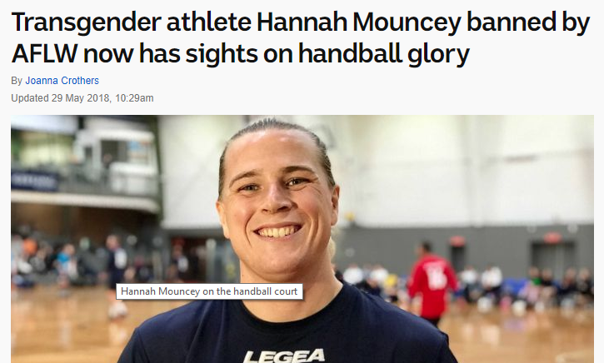
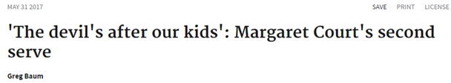
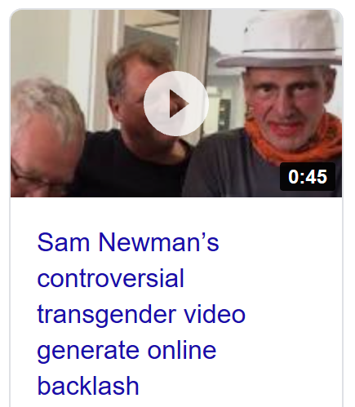
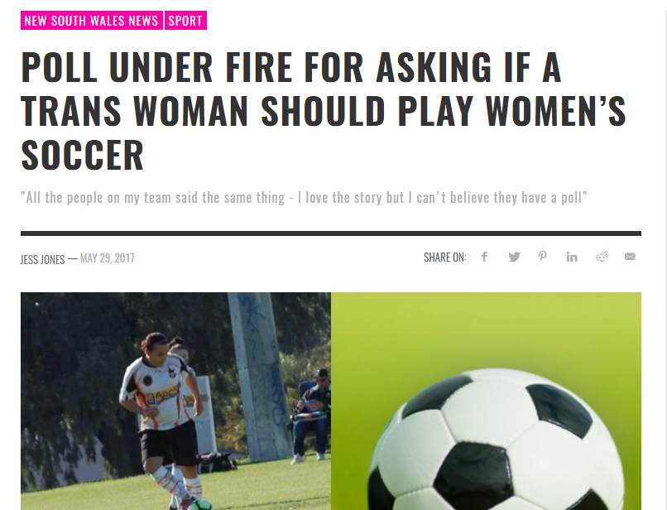
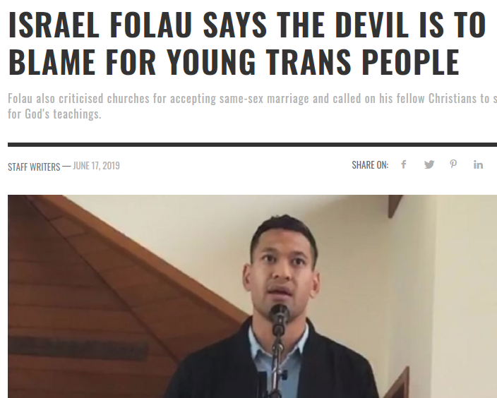
In the media

Slide 10

Gender
The range of characteristics a culture identifies as masculine or feminine.
What is considered ‘appropriate’ masculine or feminine behaviours, expressions and roles can change across cultures, locations and time.
Gender is constructed through relationships, expectations and practices that are institutionalised through family, education, religion and cultural rituals.
For example, in some western cultures women were banned from attending university or playing active sports as it was considered to impact on their fertility.

Slide 11
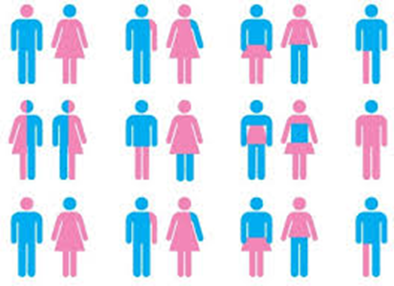
Gender norms
In many cultures, binary gender – a classification system consisting of two genders, male and female has been established as the social norm.
However, multiple gender identities and expressions exist, including transgender, gender diverse and non-binary.
Gender norms determine what is expected, allowed and valued of girls, women, boys, men, and transgender, gender diverse and non-binary people.
In most societies, including Australia, there are many differences and inequalities that exist around gender identities.

Slide 12
Terminology
Gender diverse – an umbrella term that includes all the different was gender can be perceived and experienced. It can include people questioning their gender, those who identify as trans/ transgender, gender queer, and many more.
Transgender – commonly abbreviated to trans, is a general term used to describe a person whose gender identity is different from the sex they were assigned at birth.
Gender identity – is defined as the gender related identity, appearance, mannerisms or other gender related characteristics of a person, with or without regard to the person’s designated sex at birth.
Notes:
More terminology and definitions relating to gender diversity can be found in the ‘Guidelines for the inclusion of transgender and gender diverse people in sport’ on the Sport Australia website: www.sportaus.gov.au/transgender

Slide 13
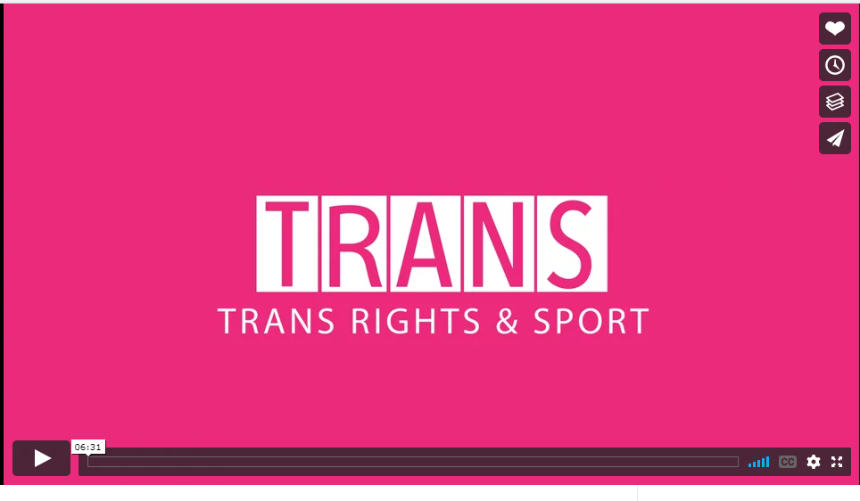

Trans and gender diverse people in sport

Slide 14
Top tips
Try to promote inclusion over exclusion and think ‘what can we do to engage this person in our club?’
Gender diversity is a complex issue. Encourage respectful dialogue and conversations.
Practice empathy and put yourself in the shoes of a trans person who just wants to play sport.
Sport does not have all the answers, nor should you. It’s ok to get things wrong. We are all learning.
For more ‘top tips’ please access the trans and gender diverse resources and tools on the Sport Australia website.
Notes:
Free speech and religious views are fine and welcome, but when they actively discriminate and stop someone from playing sport, we have a problem. They may also breach the Discrimination Act.
For more ‘top tips’ access the trans and gender diverse resources on the Sport Australia website: www.sportaus.gov.au/transgender

Slide 15
How to create inclusion at your club
Use the STAR method:
    S = Situation – What would you like to achieve at your club?
    T = Task – What do you need to achieve it?
    A = Action – How would you do it?
    R = Result – What is the outcome? How did you achieve it?

Slide 16
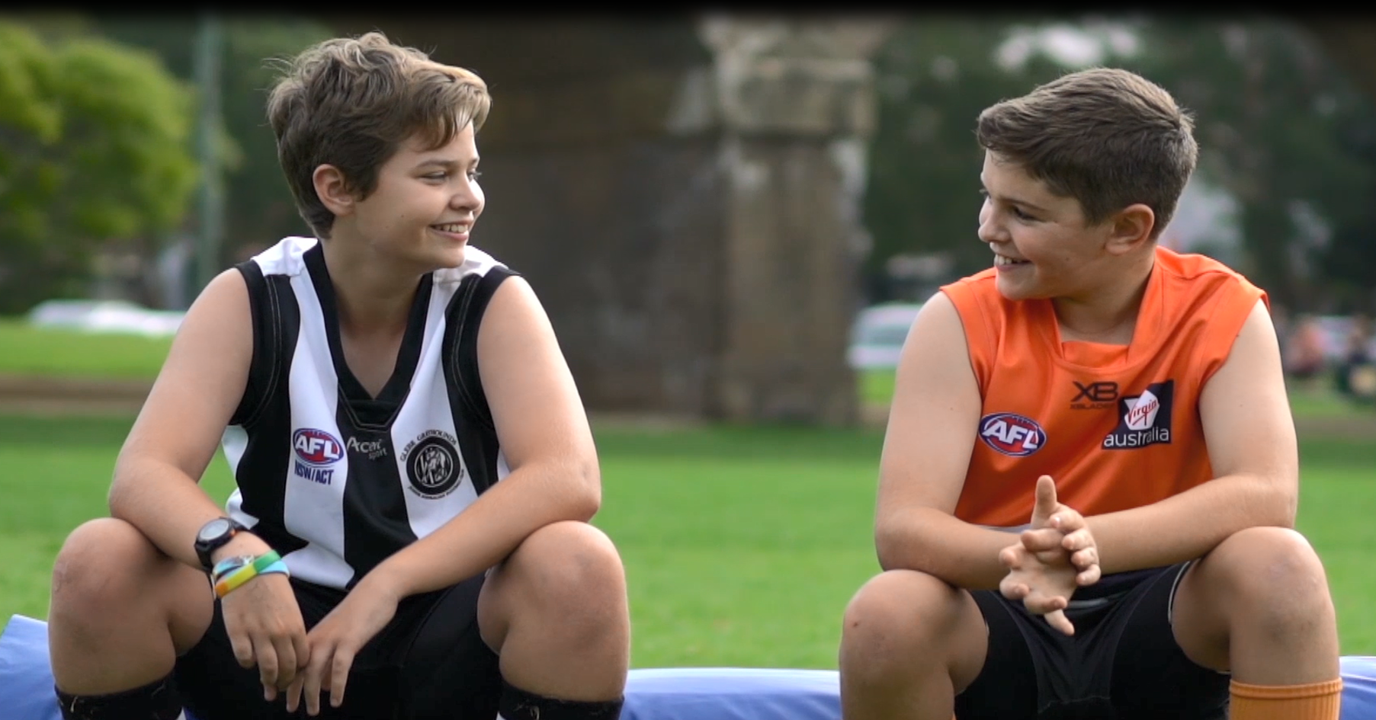
Together we can make a difference!
Find out what our club is doing to be welcoming and inclusive for everyone.
<<insert web address>>
<<insert contact name and email address>>

