Slide 1
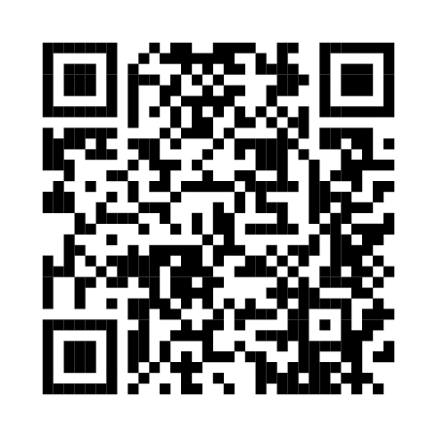
PLACE IMAGE HERE
When bystanders stay silent, it sends the message that racism is acceptable.
We all need to commit to learning more and equipping ourselves with tools, policies and processes to address racism.
Our first priority should always be ensuring the safety and wellbeing of anyone being targeted.
The burden of responsibility can’t just sit with those on the receiving end of discrimination. Allies need to stand up and carry some of the load.

Slide 2
PLACE IMAGE HERE
When bystanders stay silent, it sends the message that racism is acceptable.
We all need to commit to learning more and equipping ourselves with tools, policies and processes to address racism.
Our first priority should always be ensuring the safety and wellbeing of anyone being targeted.
The burden of responsibility can’t just sit with those on the receiving end of discrimination. Allies need to stand up and carry some of the load.
PLACE LOGO
HERE

Slide 3
PLACE IMAGE HERE
When bystanders stay silent, it sends the message that racism is acceptable.
We all need to commit to learning more and equipping ourselves with tools, policies and processes to address racism.
Our first priority should always be ensuring the safety and wellbeing of anyone being targeted.
The burden of responsibility can’t just sit with those on the receiving end of discrimination. Allies need to stand up and carry some of the load.
PLACE LOGO
HERE
PLACE LOGO
HERE

